Slide 1
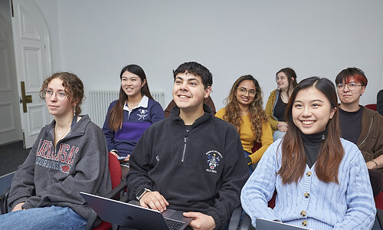
Respectful Engagement Agreement
We want everyone to feel able to contribute in this activity.
By participating, each attendee agrees that:
All communication will be respectful and considerate of people from different cultural backgrounds.
We will respect everyone’s pronouns.
We will be kind to each other and will not insult or put down other attendees.
We will contribute to the discussion with a constructive and positive approach.
We will not make exclusionary jokes or harass others.
We will take a step back if necessary, so that all people can engage.
We will respect people’s accounts of their experiences of marginalisation and will not dispute their lived experience.
We recognise the importance of pronouncing names correctly. Where possible, we will adopt strategies to avoid mispronunciation.

